Slide 1
InvestEU Green Securitisation Oslo, 24th November 2023

Slide 2
Green Investments: €36.5 billion in 2022
THE EU CLIMATE BANK
€1.8
billion
Climate change adaptation
€10.1
billion
Lower-carbon transport
€1.6
billion
€7.2
billion
Renewable energy
€7
billion
Energy efficiency
Other environmental sustainability financing*
€2.8
billion
Research, development and innovation for climate change mitigation
€6.1
billion
Other climate change mitigation

Slide 3
EIB Group Securitisation Transactions
Key Features
Cooperate with Financial Institutions: Banks or Leasing companies
The EIF fronts the guarantee, the EIB counter-guarantees
The EIB signs a Retrocession Agreement
Track Record
EUR 5.1bn signed under ESFI
EUR 1.4bn signed under EGF
Transactions signed at own risk

Slide 4
Nordic Securitisation Market
EU is smaller than the US and Asia
The EIB Group is about 1/3rd of the EU market
Christine Lagarde recently promoted securitisation
The EU’s Capital Market Union
Norway still waits for regulatory framework
Markets are very small in Sweden and Denmark
Finland has active securitisation market

Slide 5
Securitisation recap
Securitisation is the process of pooling financial assets, such as loans or mortgages, and transforming the risks and/or cash flows in horizontal tranches.
Tranching
of Credit Risk
Amortisation of repayments on Exposures
Exposure(s)
Large corporate loans
Loans to SMEs
Trade finance
Senior Tranche
Auto loans
Total Portfolio of Exposures
As Notes (securities) are traditionally issued, the product is commonly also know as Asset Backed Securities ‘ABS’.
Mortgage loans
Consumer loans
Credit cards
Mezzanine Tranche
Trade receivables
Other
Junior Tranche
Excess spread
Allocation of Losses
InvestEU focus on synthetic securitisation

Slide 6
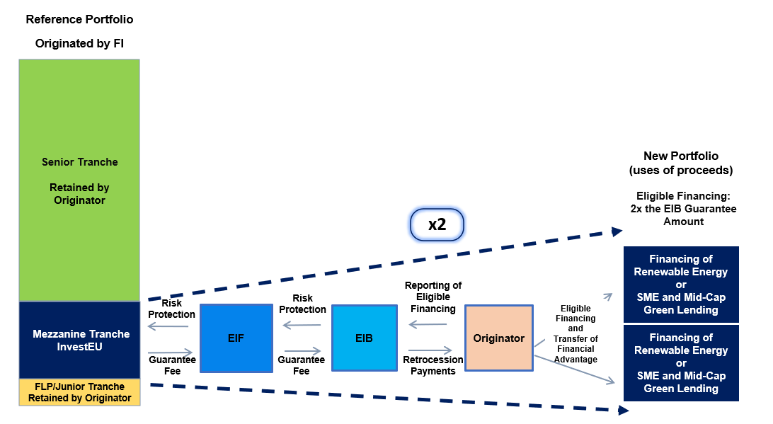
EIB Group Securitisation Transactions
New lending is 100% Green – this is “Use of Proceeds”

Slide 7
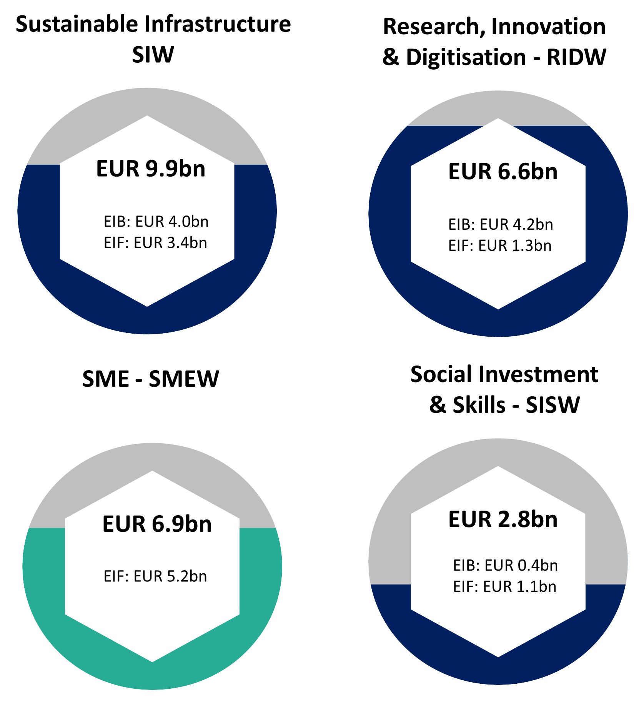
InvestEU – Green Securitisation
SIW - Investment in Green Assets
Indirect InvestEU transactions
EUR 800m envelope Mezzanine tranches
8-12 transactions
High risk = high impact Additionality

Slide 8
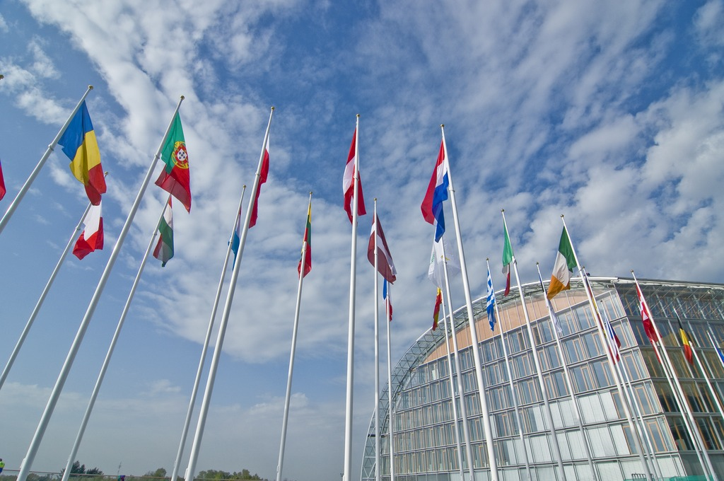
Thank you!
For further questions: info@eib.org

