Slide 1
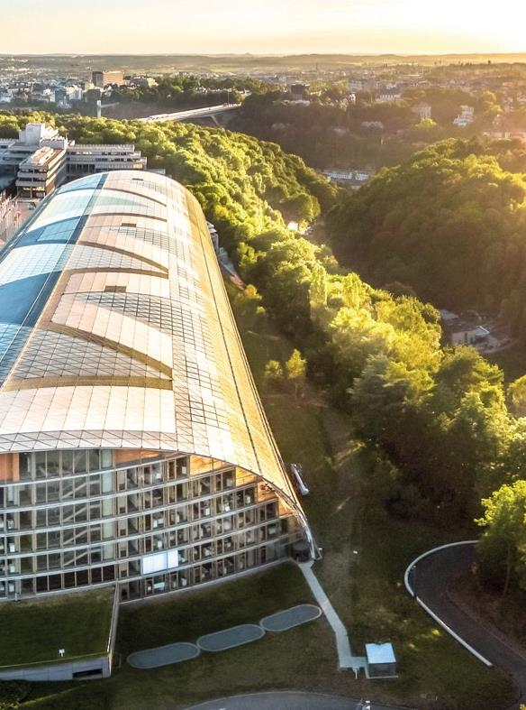
EIB
European Investment Bank
Venture Debt
Oslo, 24th November 2023

Slide 2

The EIB at a glance
The world’s largest multilateral lender
Leading provider of climate finance
Governed by the EU Member States

Slide 3







The priority areas for the European Investment Bank
Climate and environmental sustainability
Innovation and skills
Small and medium- sized enterprises
Infrastructure
Cohesion
Development

Slide 4

























EIB direct investments complement EIF fund investments
EUROPEAN INVESTMENT BANK GROUP
Direct VC investments
LP commitment
Co-investment
VENTURE CAPITAL /
PRIVATE EQUITY FUNDS
EUROPEAN SMEs

Slide 5





Our Clients
WHO IS VENTURE DEBT FOR ?
Innovation-driven companies
Investments located in EU/Norway/Iceland
Raised Series A/B equity
Strong business model, governance and management team
VENTURE DEBT - Financing the growth stage of innovative companies and for specific sectors* also the early commercialization phase
Exit / Further Series
Bank debt, M&A, Public market, etc.
Series B/C
Series A
Seed, Angels, Grants, Friends & Family, Own funds
Venture capital
Set-up
Proof of concept
Early commercialization*
Early growth
Late growth
Mature
* Target sectors for early commercialization: unmet medical needs, energy, transport, circular economy, bio-economy, CCU(S)
5
22/11/2023

Slide 6



Our Added Value
The venture debt product has become a flagship equity financing instrument for EIB.
VENTURE DEBT
Venture debt is a loan with the pricing linked to the performance of the company.
It typically finances the stages with the highest capital requirements (first and second “valley of death”) for startups/ midcaps: the early commercialisation phase and growth stage.
Bridges the growth stage and the early commercialisation market financing gap
Showcases EIB’s and EU’s strategic priorities
Direct financing of highly innovative companies.
Allows active and targeted geographic diversification across the EU, Norway and Iceland.
6
22/11/2023

Slide 7










Our Sectors (1/2)
Medical services
Life sciences
Massive, sustainable savings of CO2 emissions enabled by technology
Biotechnology and drug development
Software with emphasis on AI/ML and cybersecurity
ICT Equipment and robotics
IT Services and
e-commerce
Thousands of jobs supported (mostly high skilled)
ICT
Medical technologies
Improved quality of life for millions
Advanced manufacturing and industrial innovation
Chemicals
Engineering

Slide 8










Our Sectors (2/2)
ENERGY
MOBILITY
CIRCULAR ECONOMY
BIO-Economy
LOW-carbon solutions
Renewable energy technologies (wind, wave, solar, etc.)
New and adapted transport services and infrastructure (e.g. charging networks, drone delivery)
Sustainable end-product, byproduct and waste product recycling.
Sustainability and climate mitigation in food production and supply chains, agriculture, farming, forestry and blue economy
CCU(S)
Energy storage
Digitalisation of the transport sector and manufacturing of green mobile assets
Carbon reduction for energy intensive heavy industry
Demand response and smart grid solutions
Alternative fuels for HGV, Maritime and Aviation – Green H2 and Methanol
Key sectors include: textiles, plastics, packaging, ICT, batteries, vehicles, construction materials, food, water, critical raw materials, nutrients and energy equipment
And more…
And more…
And more…
And more…

Slide 9
Our Venture Debt Product
Up-front commitment of the full amount and gradual disbursements
Subsequent disbursements are subject to business and financial milestones (substantially de-risking tranches 2 and 3 if applicable)
Availability of typically 36 months to accommodate long term investment plans of technology companies and scale-ups
Large EIB tickets possible (circa EUR 7.5-50m) following a co-investment principle (max. 50%)
Bullet structure to facilitate repayment based on an exit (or amortising structure if preferred)
Maturity to accommodate time to full profitability
Remuneration may include warrants, interest, PIK, royalties or other, alone or in combination
Limited security package
Cash flows / cash balance
Disbursement
Repayment
Commitment
Disbursement
Repayment
Year 1
Year 2
Year 3
Year 4
Year 5
Year 6
Year 7
Year 8

Slide 10



Advantages of the EIB Venture Debt Product
COMPANY
INVESTORS
Long tenor allows a company to focus on business growth
Large tickets to support growth and scale-up and increase the runway to next funding round
EIB is a stable and reliable investor with a triple-A rating
Flexible terms and customized structures based on company’s needs
Quality stamp – increased market visibility and credibility for the company
Accelerates the deployment of the business plan and de-risks related innovation
Complimentary to equity investment
Limited dilution and loss of control
Enhanced returns for equity investors
Reduce pressure on equity needs
Long-term loans match timing of investment
FOUNDERS
Limited dilution and loss of control
Hands-off approach – no direct involvement
Extend time to next funding round
Market visibility after EIB investment

Slide 11












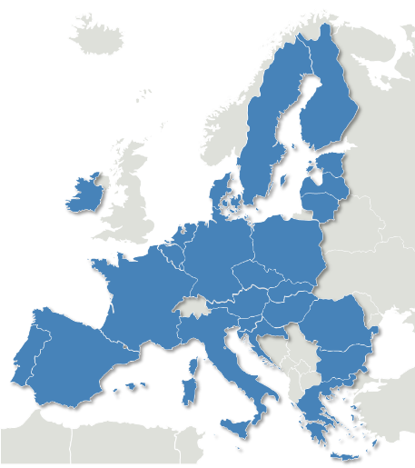













































































Our Track Record (November 2023)
Financing committed
€5.84bn
Companies financed
270+
Jobs supported
36,500 +

Slide 12






Our Appraisal Process
SCREENING
Investment, technical, EC criteria*
APPRAISAL
Financial, economic, ESG and Technical DD
APPROVAL IN PRINCIPLE
Investment Committee
LEGAL DOCUMENTATION
Detailed negotiation
SIGNATURE
Commercial and
financial close
TIMING
Depending on the complexity of the transaction financial close can be achieved in 6 months
HIGH LEVEL TERMS
* For certain cases, the eligibility needs to be confirmed by the European Commission

Slide 13
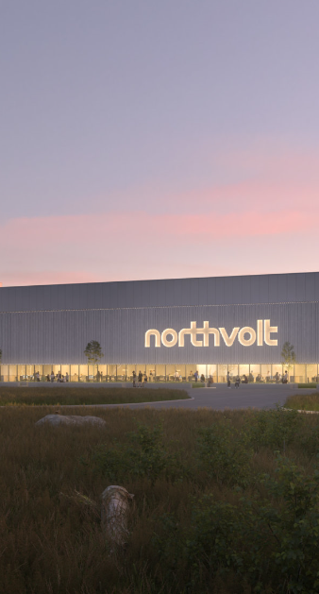

Demonstration manufacturing Plant for large Scale Production of Li-ion Batteries
Amount: EUR 52.5m
Sector: Energy Storage
Country: Sweden
Signed: 2018
EUR 52.5m loan for the construction and operation of a first-of-a-kind demonstration plant in Sweden, for the manufacturing of li-ion batteries
The facility serves to show the commercial viability of the concept and to qualify and industrialize products together with Northvolt’s customers. The produced batteries are targeted for use in transport, stationary storage, and industrial and consumer applications
The demonstration site will also comprise a research facility and in total the operations will employ between 300-400 people. The launch of the demonstration plant is a key step towards the establishment of Northvolt’s large-scale li-ion battery factory, eventually targeting a production of 32 GWh worth of battery capacity annually
INVESTMENT RATIONALE/IMPACT:
Supports the roll-out of EVs through the development of the upstream activities of the value chain
Demonstrates and allows to qualify innovative products with customers
Catalysing effect to attract financiers and pave the way for the scale-up

Slide 14
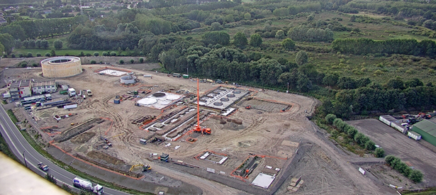


Decarbonization of the Steel Industry
Amount: EUR 75m
Sector: Decarbonisation steel industry
Country: Belgium
Signed: 2019
INVESTMENT RATIONALE/IMPACT:
The projects are set to reduce up to 350,000 tonnes of CO2 emissions per year in the first phase
Industrial-scale demonstration of innovative technologies that support the decarbonization of the steel industry
Accelerates the transition needed in the steel industry to meet the EU’s climate objectives
EUR 75m loan to C-Shift a Belgian company wholly owned by ArcelorMittal Belgium, part of ArcelorMittal Group
The loan is supporting two demonstration projects worth EUR 215m in total:
      Torero: a EUR 50m plant to convert waste wood into bio-coal, partially replacing the coal currently injected into the blast furnace
      Steelanol : a EUR 165m plant that will capture waste gases from a blast furnace and biologically convert them into recycled-carbonethanol. The ethanol produced can be blended for use as a liquid fuel

Slide 15
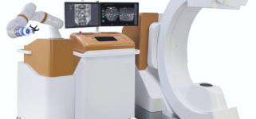
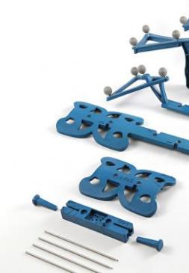

Innovative 2D/3D Imaging Systems and computer-assisted Surgery
Amount: EUR 15m
Sector: Robotics
Country: France
Signed: 2021
INVESTMENT RATIONALE/IMPACT:
Significant unmet medical need and potential billion euro market
Very high entry barriers
Expansion opportunities to other organs
Partnership with J&J and Signus
Strong IP protection
Founded in 2009 by Stephane Lavallée, a serial entrepreneur in the field of smart medical devices such as computer-aided surgery, robotics, medical imaging, smart implants, and instruments, Ecential Robotics specialises in the development of innovative systems of 2D and 3D imaging and computer-assisted surgery.
Only fully unified solution combining an imaging acquisition system, a real time navigation system and a robotic arm, operating on the same software, ensuring perfect calibration between all elements at any point in time and without specific maintenance.
By improving precision and accuracy during orthopedic and traumatological surgery, Ecential Robotics’ system enables healthcare professionals to perform the most complex actions in a safer manner.
Ecential Robotics operates in the booming field of robotic surgery which is estimated to be worth around EUR 5bn and expected to grow at a CAGR of c. 13% over the next 5 years.
Headquartered in La Tronche near Grenoble, the Company currently employs some 70 highly skilled FTEs.

Slide 16




Upcycling crop leftovers to produce nutraceutical ingredients
Amount: EUR 40m
Sector: Food industry
Countries: Denmark
Signed : 2023
INVESTMENT RATIONALE/IMPACT:
    Circular economy
    Bioeconomy innovation
    Early-stage company
    Replicable First-of-a-Kind project
    Project utilizes an efficient industrial symbiosis (coordination) model between Meliora Bio’s bioethanol and the COMET’s ArrabinaTM production processes, feedstock sourcing, logistics and infrastructure.
Founded in 2009, Comet is a food technology company upcycling crop leftovers (e.g. wheat straw) into ArrabinaTM, a trademarked natural prebiotic, dietary fibre that can be added to foods and beverages in order to facilitate digestion, help control blood sugar levels and improve microbiome health.
EUR 40m to Comet Bio Denmark Aps for the financing of part of a first-of-a-kind plant for the production of a novel prebiotic fibre ingredient for the food and beverage industry in Kalundborg (Denmark). The project finances the RDI and CAPEX to optimise, design, procure and integrate spray-drying technology in the plant, to produce the ingredient in dry-powder form. It will also finance optimisation of the overall production technology and achieve a production output of 5,000 tonnes per year (plant de-bottlenecking).

Slide 17
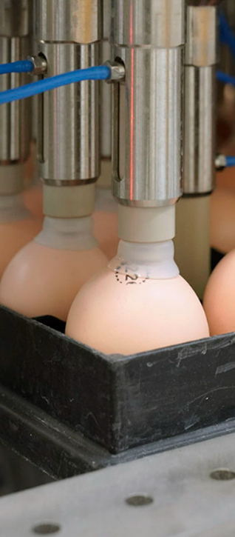


Ending the culling of male chicks and improving animal welfare
Amount: EUR 40m
Sector: Support activities for animal production
Country: Netherlands
Signed: 2023
EUR 40m venture debt financing to In Ovo Holding BV, a European leader in developing solutions to prevent selective slaughters of male chicks. It aims to become a global player in this niche market.
Founded in 2013 in The Netherlands, the Company solutions aim at ending the routine culling of male chicks, improve animal health and welfare, productivity, traceability, and decrease waste for producers.
The EIB loan will finance the development and improvement of equipment and technology that identify the sex of eggs, the monitoring of chicks’ health during incubation and breeding as well as a data platform and a line of chicken enrichment tools to reduce stress in bread chickens.
INVESTMENT RATIONALE/IMPACT:
Supports the development and improvement of equipment and technology for animal wellbeing
Aligned with EU’s Farm to Fork Strategy
Catalysing effect to attract financiers in a niche sector

Slide 18
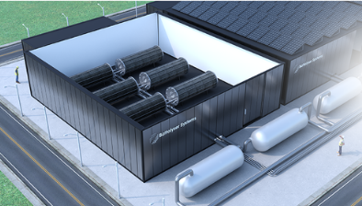
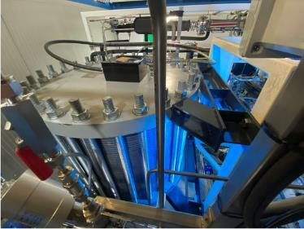


First-of-its-kind electrolyser stack of cells to produce green hydrogen
Amount: EUR 40m
Sector: Green hydrogen
Country: Netherlands
Signed : 2023
INVESTMENT RATIONALE/IMPACT:
    Decarbonisation of energy
    RDI activities in the green hydrogen sector facing significant challenges (operating performance, energy efficiency and levelized cost of production)
    Innovative SME start-up
Battolyser BV, a Dutch company is developing the “Battolyser”, an integrated battery and electrolyser that can produce electricity with hydrogen as well as electrolyse water to produce hydrogen.
The battery function allows to balance intermittent renewable electricity, either by charging from the grid when electricity prices are low or discharging and returning electricity to the grid when prices are high, and when the battery is fully charged the ‘Battolyser’ can produce hydrogen. Alternatively, the battery may be used to support a steadier continuous production of hydrogen from an intermittent renewable electricity source. It is expected to enable users to achieve a low and competitive cost to produce hydrogen.
The EIB financing will enable the Borrower to build a first-of-its-kind factory and 2 subsequent factories to produce Battolysers and service them.

Slide 19

Venture Debt Team
How to apply:
Send us an email and fill in the web/eligibility questionnaire
Contact details:
François GAUDET
Head of Unit,
Cleantech Equity & Growth Finance division
Phone: (+352) 4379-85154
Cell: (+352) 621 459 174
E-Mail: f.gaudet@eib.org
European Investment Bank
100, boulevard Konrad Adenauer
L-2950 Luxembourg

Slide 20
Our Team
More than 140 people within the EIB dealing with equity-risk operations
Operations
More than 30 people dedicated to direct quasi-equity operations
Projects
More than 30 people with sector background covering ICT, engineering, life sciences and renewable energy
Legal
More than 15 lawyers specialised in equity and quasi-equity structures
Risk Management
More than 15 risk managers reviewing all quasi-equity and equity risk investments
Transactions Monitoring (TMR)
More than 32 officers monitoring and providing independent valuation process
EIB has dedicated teams, risk policies and approval processes for direct equity type financing.
1,500+ project proposals reviewed each year.
Expertise from public and private institutions
Front Office (Operations) and Monitoring teams typically employing officers with 10-20+ years experience in equity type financing from investment funds, development banking, investment banking, corporate finance
Dedicated legal team with expertise in quasi-equity structuring
Strong technology expertise
Projects (PJ) team conducts technical due diligence with officers with first hand specialised experience from leading technology companies in energy, transport, circular economy, bio economy, CCU(s), critical raw materials, automotive, software development, engineering, life sciences, etc..

Slide 21

What can be financed
EIB Financing is determined on the basis of the planned investment plan
Funding of the investment plan
Uses
Sources
In accordance with its co-investment principle, the EIB ticket size is capped at 50% of the investment plan
Other costs
Marketing, Sales
EIB Venture Debt
Working capital needs
Research and development and/or CAPEX costs
related to the project
Other financing sources (e.g. commercial banks, grants)
EUR 15 m
≤
The minimum required investment plan is EUR 15m (minimum EIB ticket of EUR 7.5m )
Equity

Slide 22
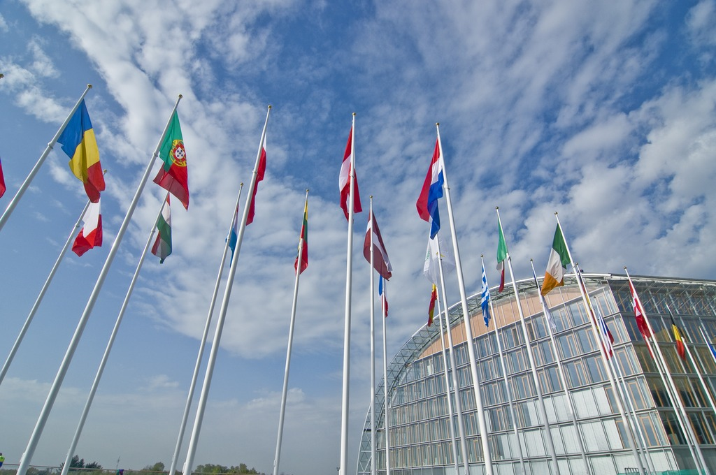
Thank you for joining us!

